Slide 1

FACIAL EMOTION RECOGNITION USING ML ALGORITHMS
Date: 08 April 2021
V.V.S.S.RAMYA : 17WH1A0501
SK.AFIFARESHMA : 17WH1A0535
AFRAH SAMREEN : 17WH1A0526
Internal Guide: Mr. U.CHANDRASEKHAR
Designation: Associate Professor
Department of Computer Science & Engineering
BVRIT HYDERABAD College of Engineering for Women

Slide 2
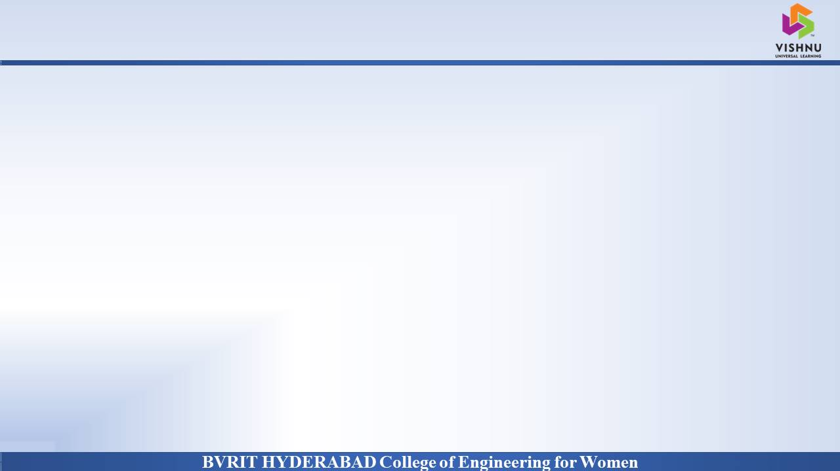
Why Should I Study this course?
PROJECT INTRODUCTION
DOMAIN : Machine Learning
PROJECT OVERVIEW : Facial expression for emotion detection has always been a challenging task in achieving through computer algorithms. With the recent advancement in computer vision and machine learning, it is possible to detect emotion from images. In this project we propose a technique called facial emotion recognition using convolutional neural networks.
Examples
BVRIT HYDERABAD College of Engineering for Women

Slide 3
SYSTEM SPECIFICATIONS
Hardware : Processor - Intel Core i5
Memory - 8GB
Storage - 1TB
Software : Python
OS-Windows 10
Google Colab
BVRIT HYDERABAD College of Engineering for Women

Slide 4
REFERENCES
Base Paper :
Shichuan Du, Yong Tao, and Aleix M. Martinez1 Department of Electrical and Computer Engineering, and Center for Cognitive and Brain Sciences, The Ohio State University, Columbus, OH 43210 Edited by David J. Heeger, New York University, New York, NY, and approved February 28, 2014
Reference Paper :
https://www.researchgate.net/publication/343443531_Facial_Emotion_Recognition_A_Brief_Review
BVRIT HYDERABAD College of Engineering for Women

Slide 5
Thank you
BVRIT HYDERABAD College of Engineering for Women

